Slide 1
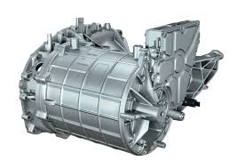
Electrical Engine Efficiency Prediction
Bypassing Finite Element Analysis

Slide 2
Lilly Abraham (Matriculation ID : 5123768)
Supervisors
Prof. Dr. Magda Gregorová
Prof. Dr.-Ing. Mercedes Herranz Gracia
In collaboration with Valeo
Daniel Fritsch

Slide 3
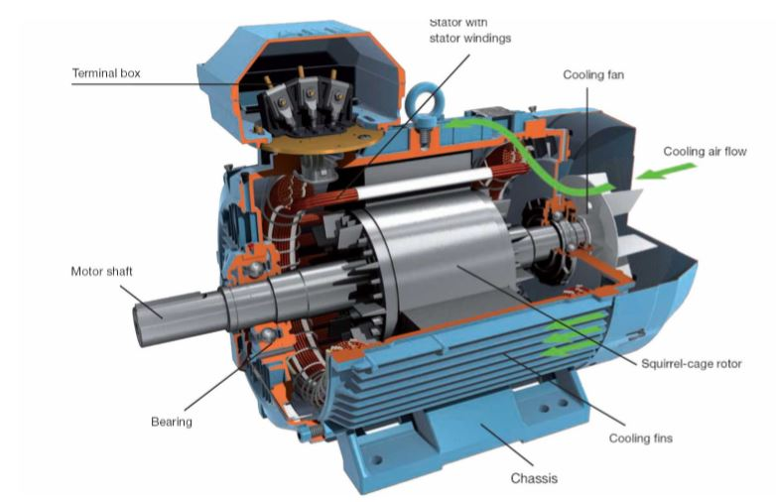

Introduction : Electric Motor (EM)

Slide 4

Applications

Slide 5

Objective
To predict 2 KPIs of topology invariant PMSM Electric Motors designs

Slide 6
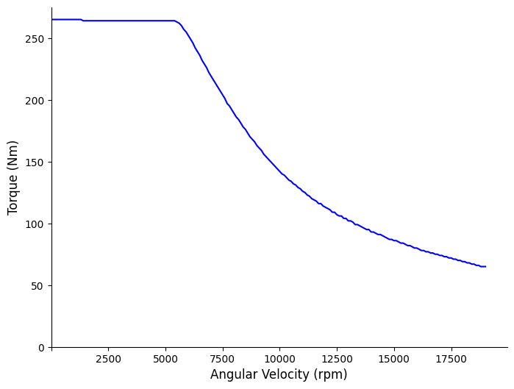
Torque Curve

Slide 7
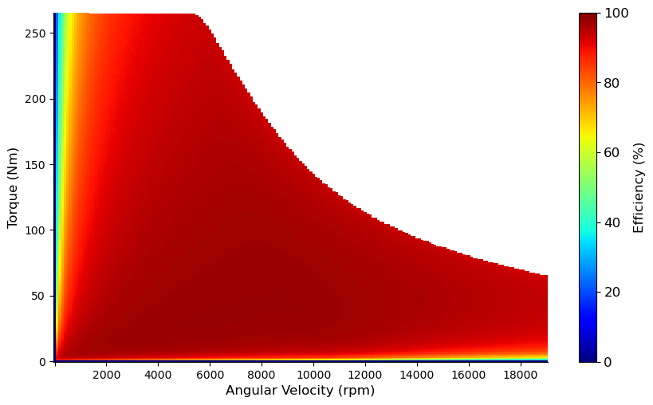
Efficiency Map

Slide 8

Objective
To predict 2 KPIs of topology invariant PMSM Electric Motors designs
Surrogate Modelling Finite Element Analysis

Slide 9
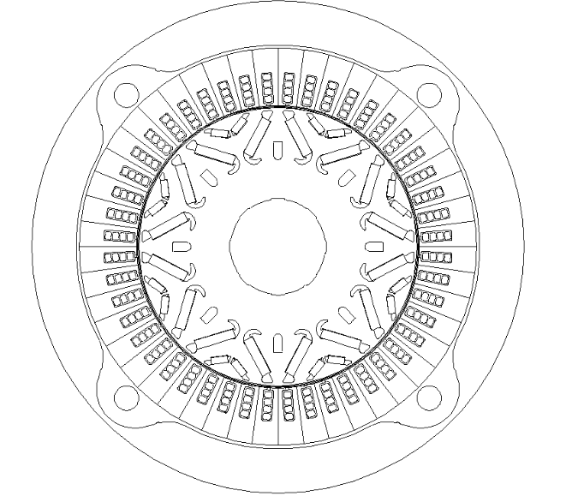
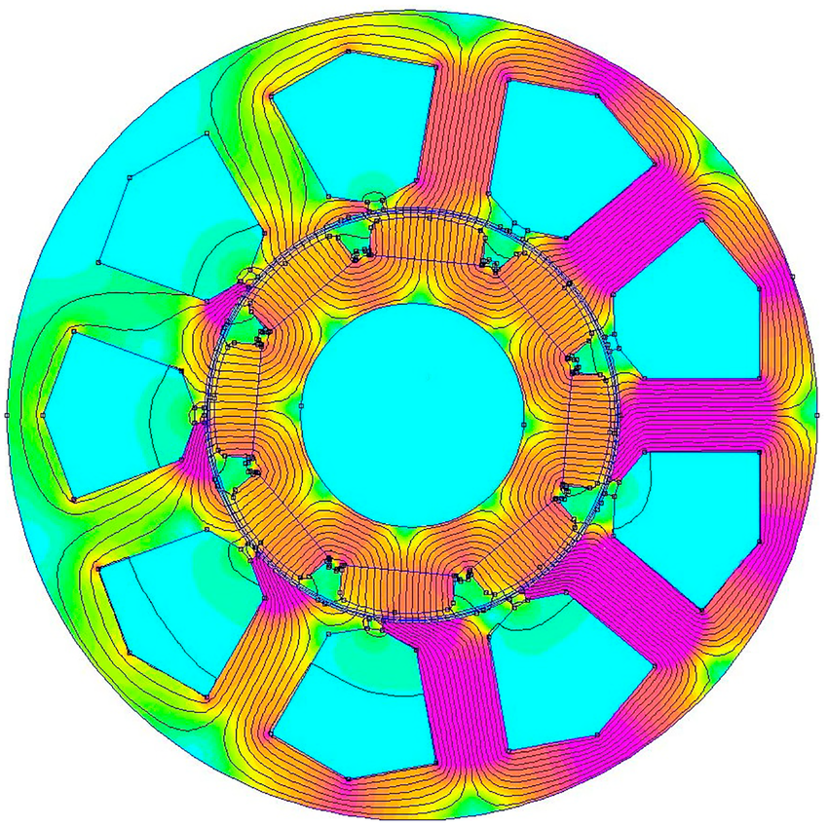
Finite Element Analysis (FEA)

Slide 10


Objective
To predict 2 KPIs of topology invariant PMSM Electric Motors designs
Surrogate Modelling Finite Element Analysis
Multi Regression Supervised Learning Problem

Slide 11
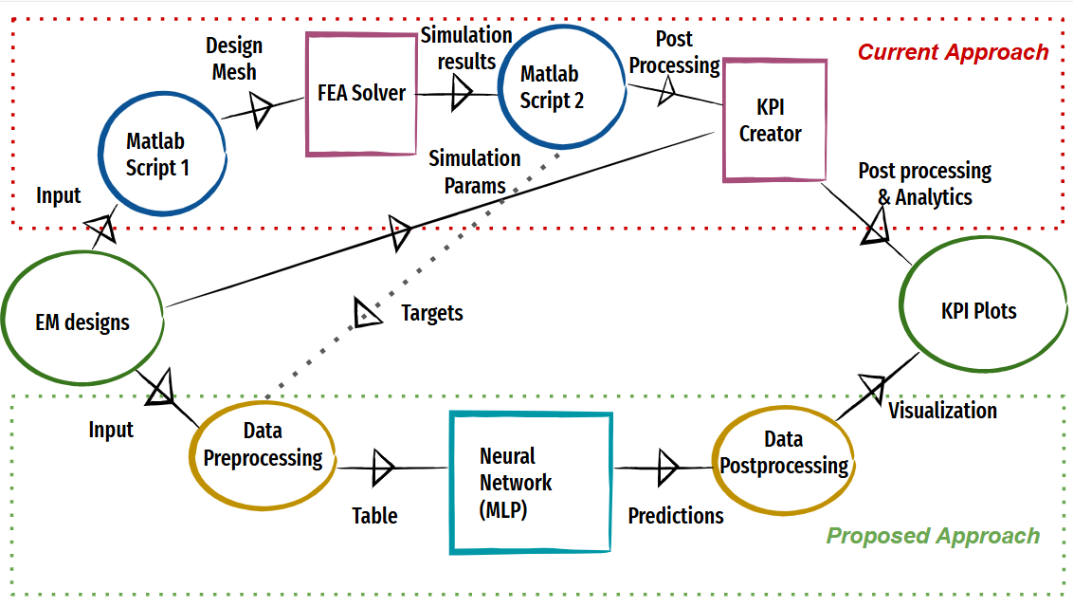
Process Flowchart

Slide 12
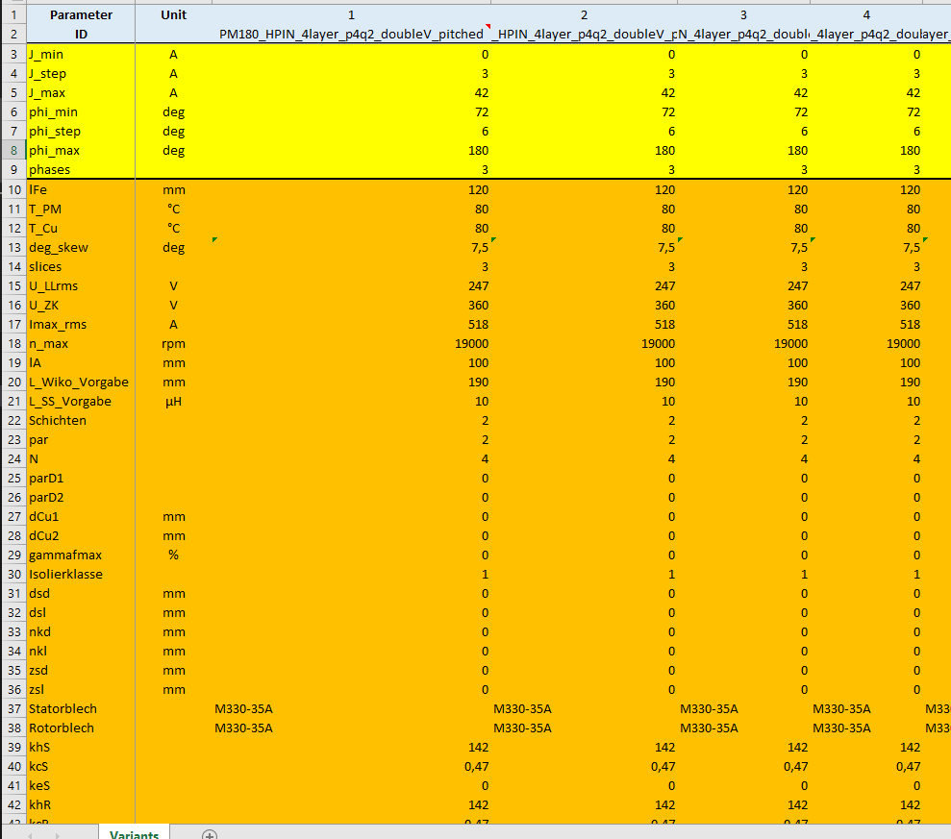

Dataset
Parametric description of 1475 Double V magnet EM
3 additional per topology

Slide 13
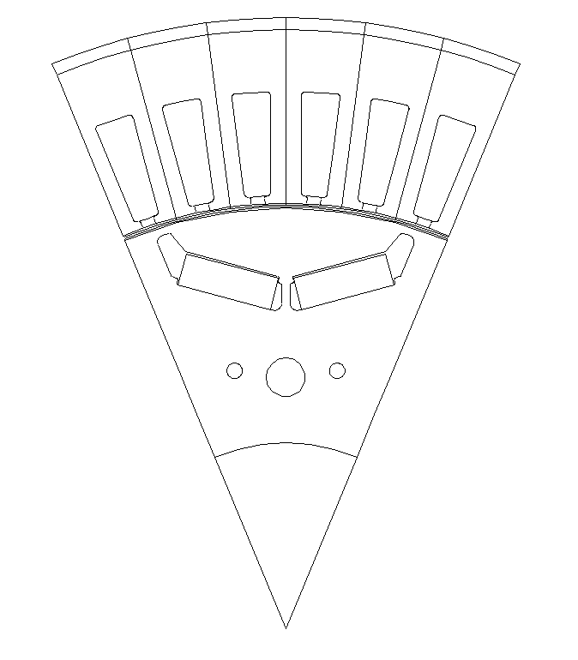
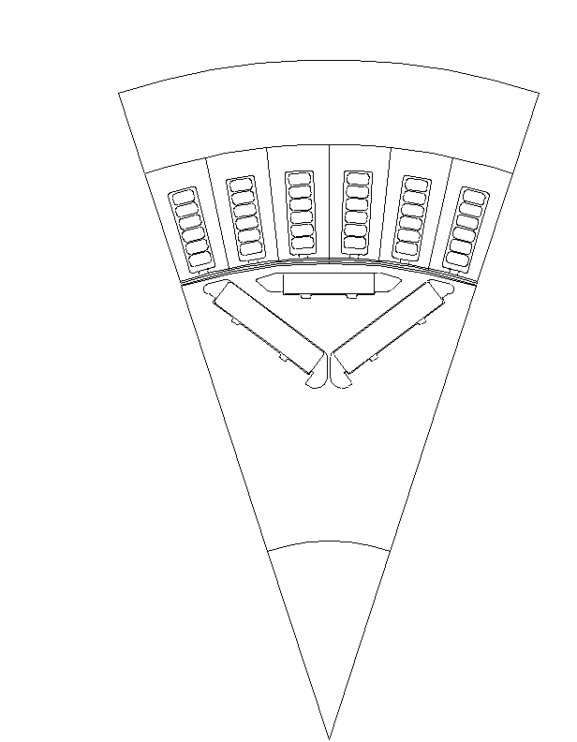
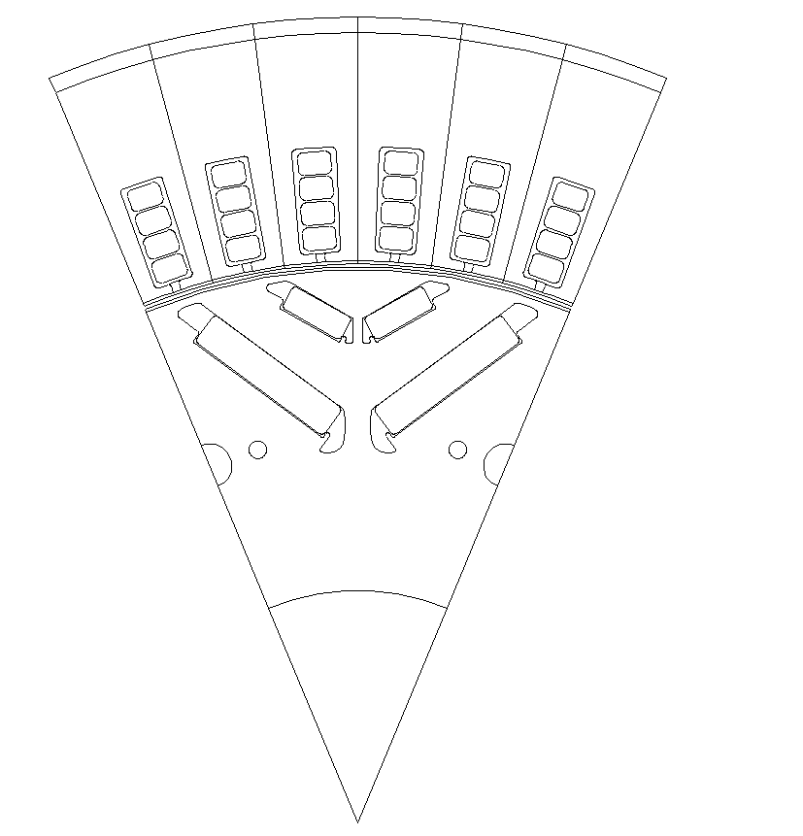
Topologies
Single V Magnet
Nabla Magnet
Double V Magnet

Slide 14
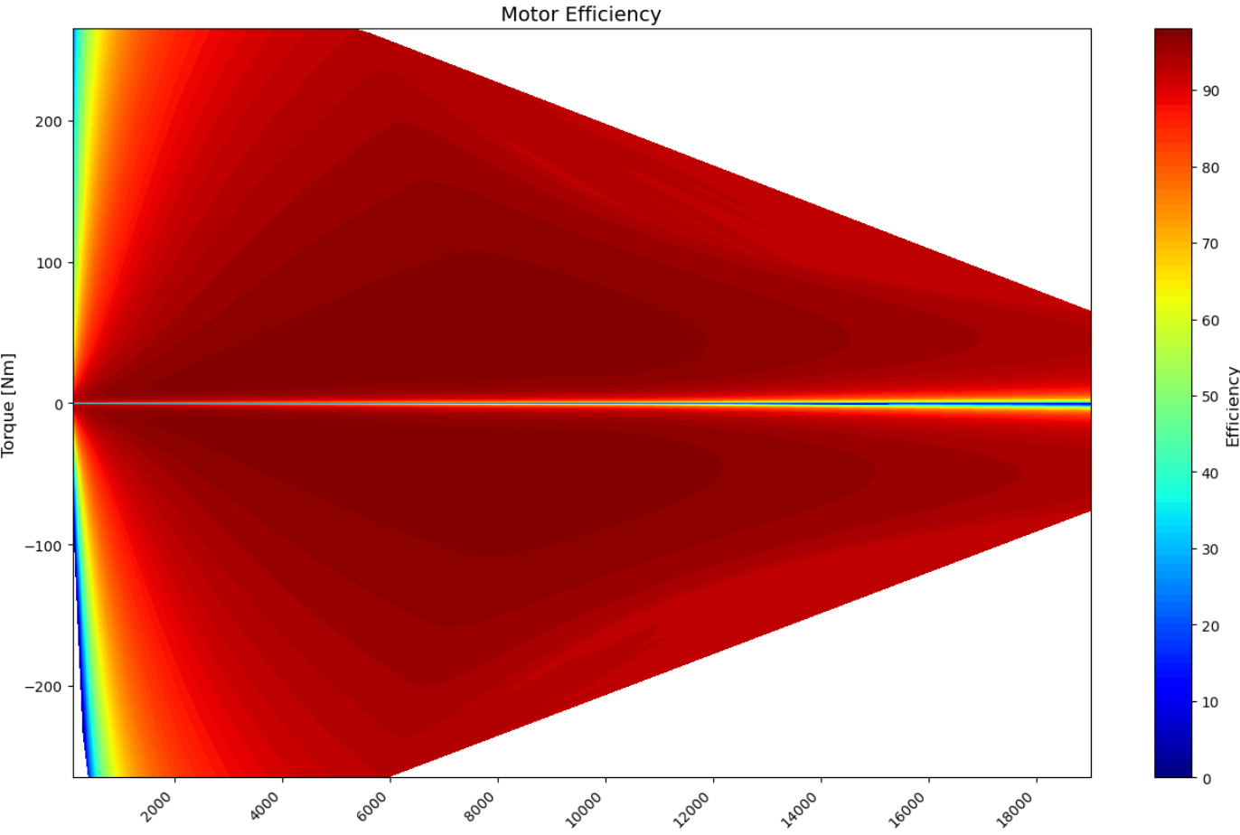
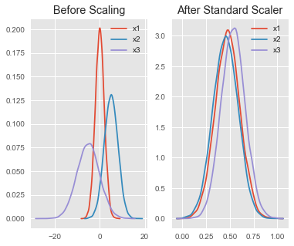
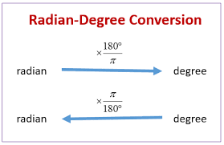
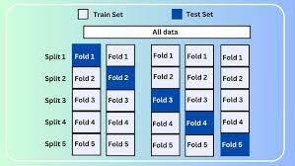
Data Preprocessing

Slide 15
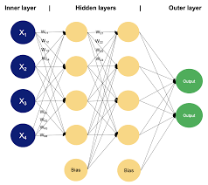
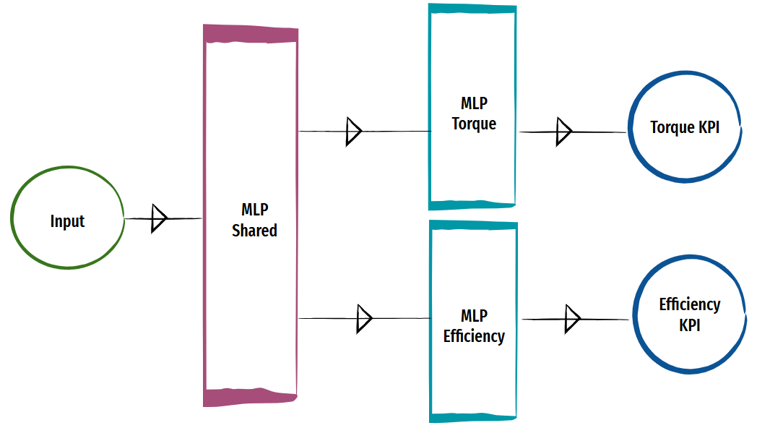
Modelling
Multi Layer Perceptron (MLP) Model

Slide 16
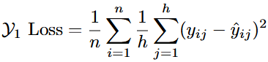
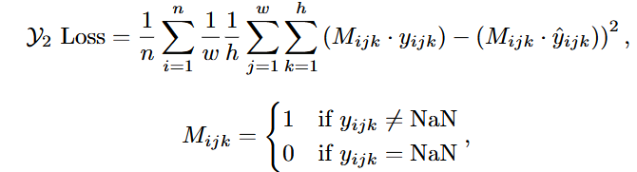
Loss Function
Mean Squared Error (MSE)

Slide 17
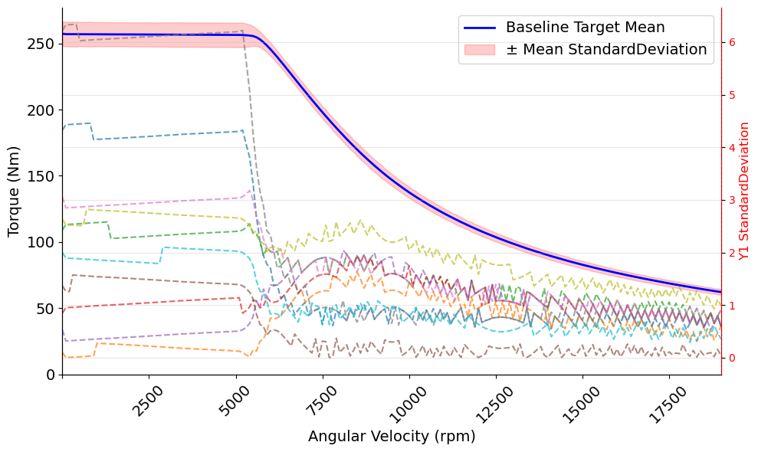
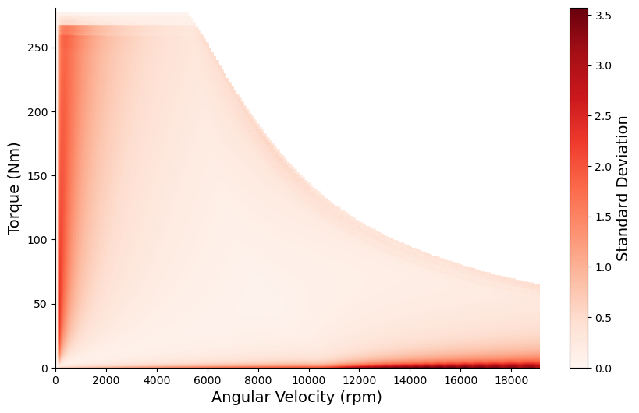
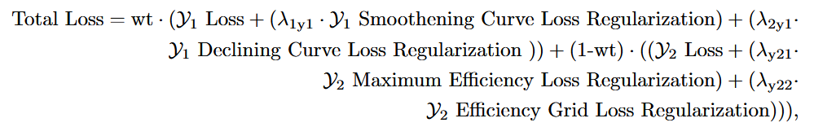
Loss Function Regularization

Slide 18
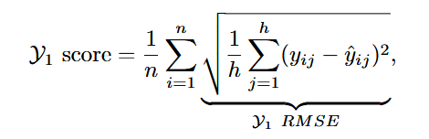
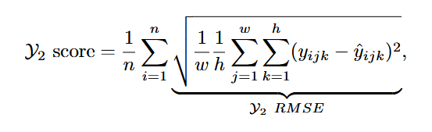
Evaluation
Root Mean Squared Error (MSE)

Slide 19
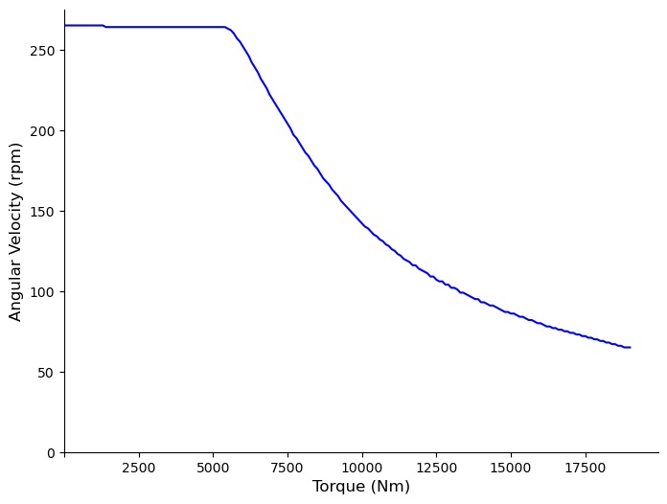
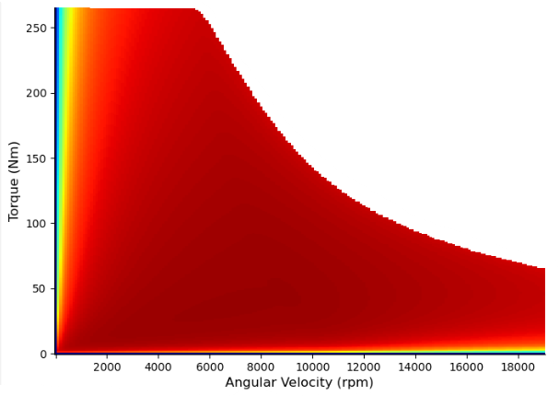
Post Processing

Slide 20
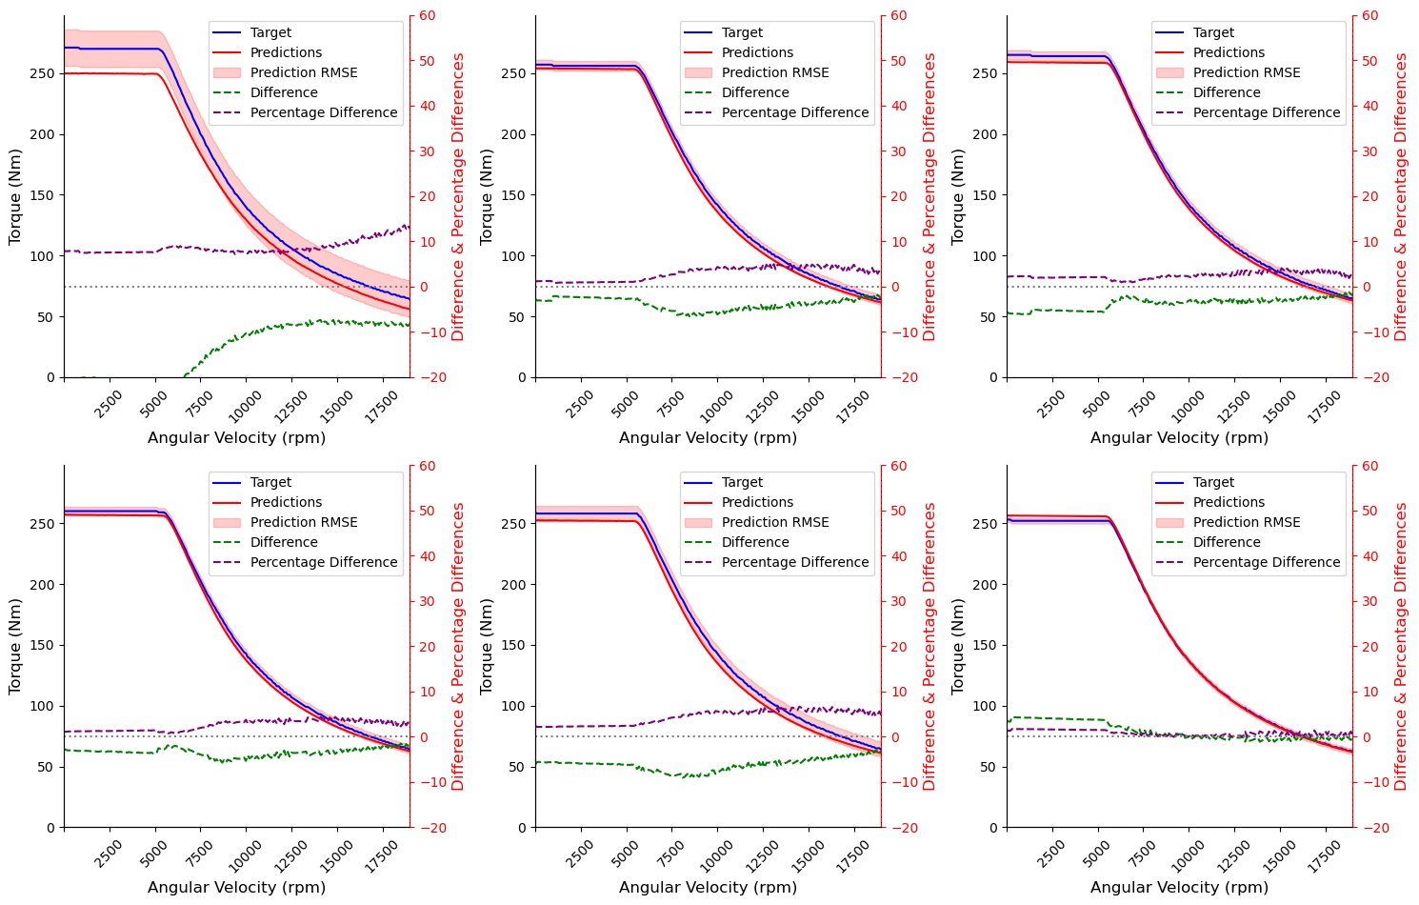
Results
Torque KPI Results

Slide 21
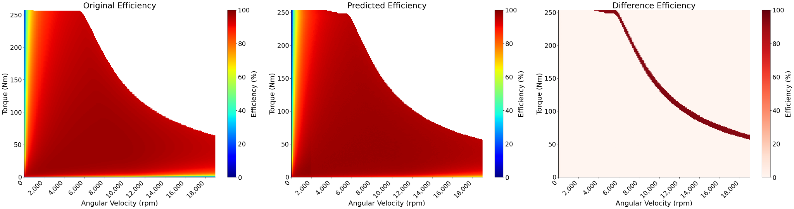
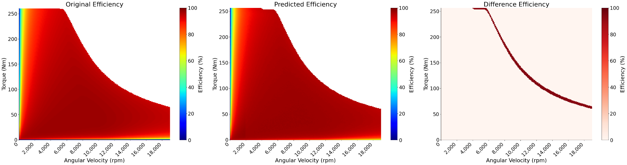
Efficiency KPI Results

Slide 22
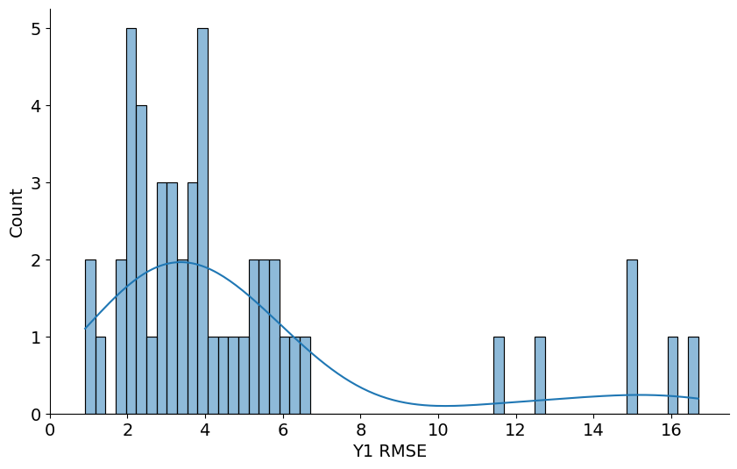
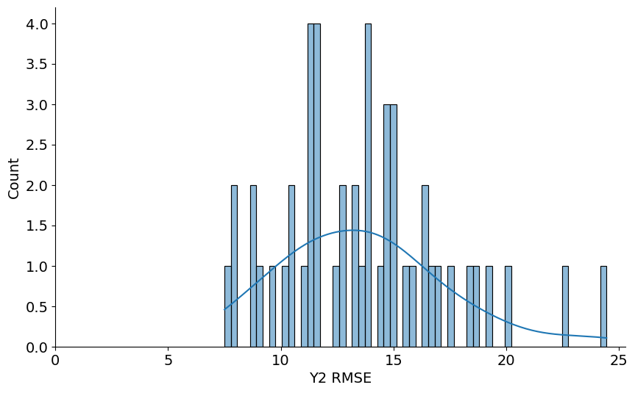
Predicted KPIs Evaluation
Torque KPI Scoring (Value Range : 55-280)
Efficiency KPI Scoring (Value Range : 0-100)

Slide 23
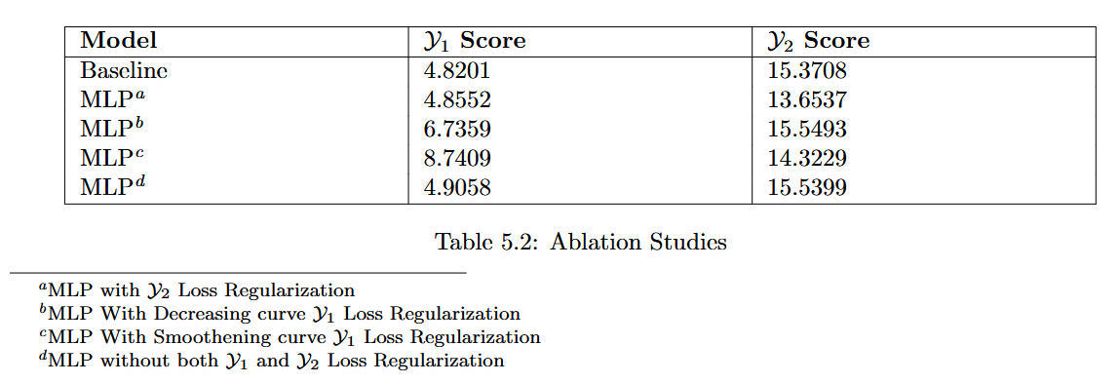
Ablation Studies

Slide 24
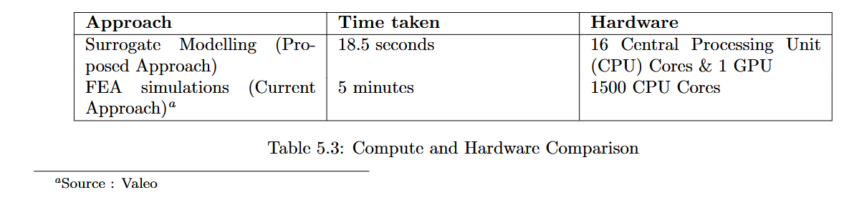
Comparisons

Slide 25
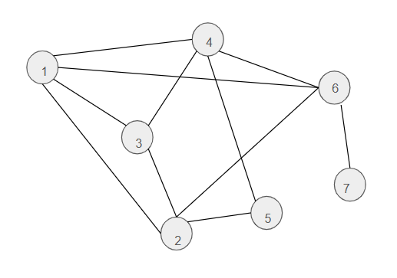
Case Study
Graph Representation
Message Passing

Slide 26
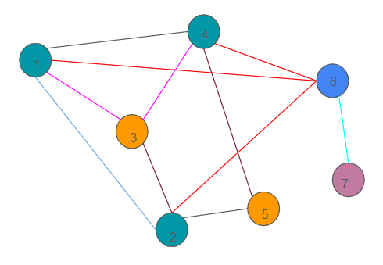
Heterogeneous Graph
Topology Invariance
Meta path based
Meta path free

Slide 27
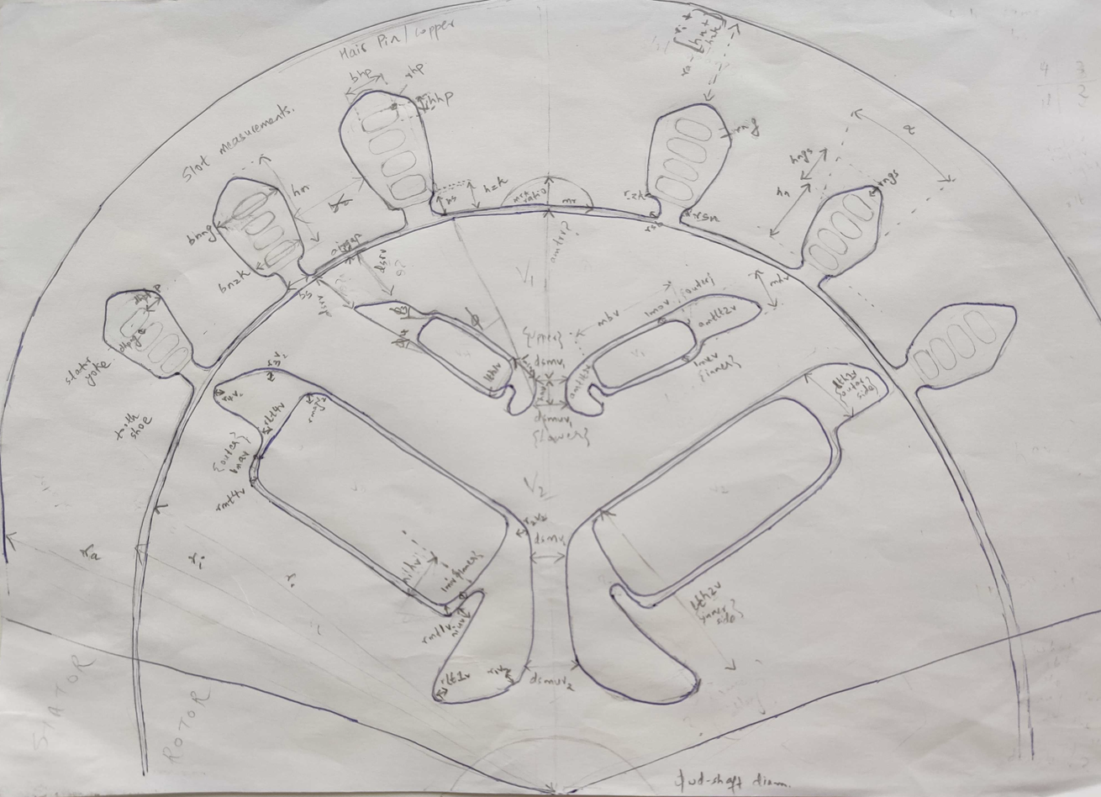
Double V PMSM EM Cross-section

Slide 28
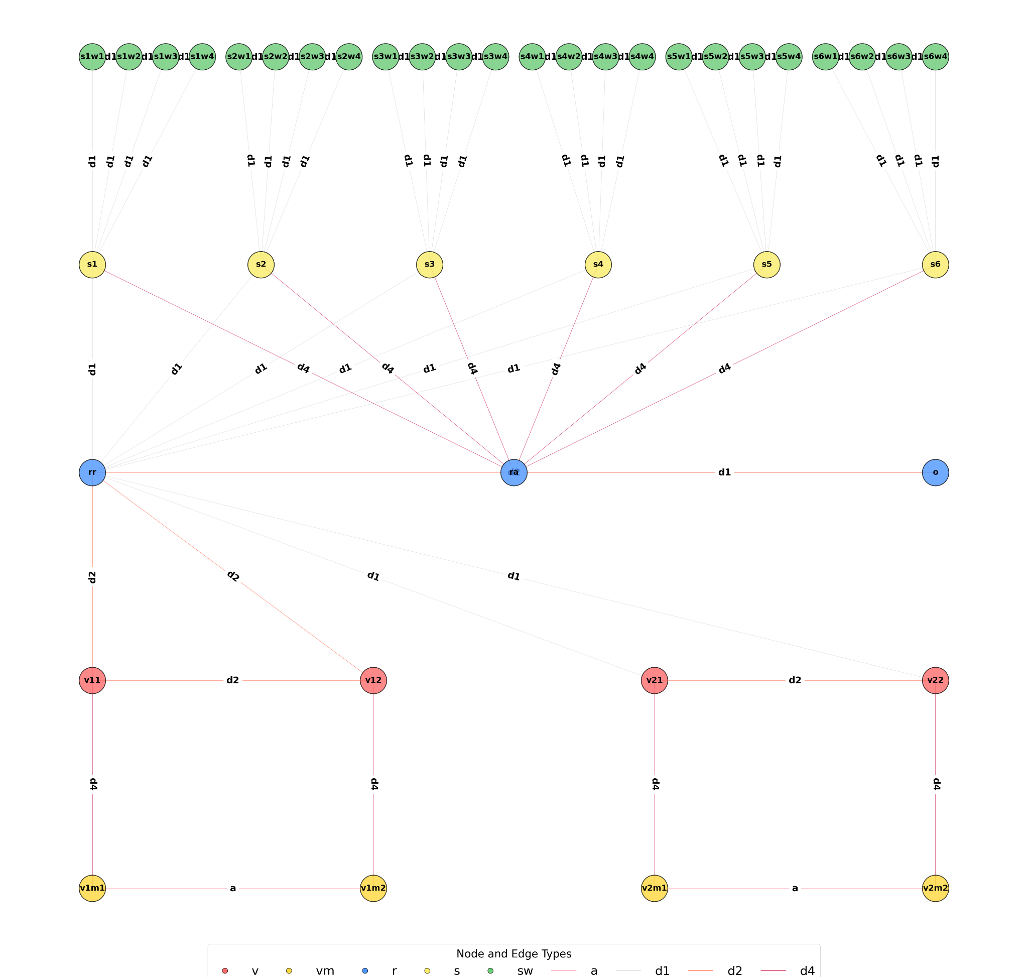
Double V PMSM EM Heterogeneous Graph

Slide 29
Conclusion
01
02
03
04
Topology in-variance * MLP - sparsity introduced can hamper memory usage * GNN - do not introduce sparsity
Efficiency KPI regularizations improved the scores of our evaluation metric.
Torque KPI deviations from the targets by close to 2% difference
Efficiency KPI deviations from the targets by close to 14% difference
05
MLP approach is about 16X faster than FEA Solver with almost comparable performance.
06
Lays the foundation for inverse formulation of the task.

Slide 30

Thank you

